Slide 1
The Science and Technology of Consciousness
Modern Science Discovers
the Revival of an Ancient Science
Personal Experience

Slide 2
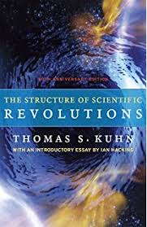
How Paradigms Shift

Slide 3
Paradigm Shifts: Scientific Revolutions
The Shift from the Matter-based Paradigm to
The Unified Field-based Paradigm
(Quantum Physics/Relativity Theory)
and
The Consciousness-based Paradigm
(Science & Technology of Consciousness)
Notes:
We talked this morning about how the nature of life is to grow and how part of that process of growing up, for instance, involves our perspective shifting as we grow. This afternoon we are going to discuss how Science grows, how expanding our paradigm, the perspective of science, mirrors how our perspective expands as we grow from an embryo to maturity. The history of science is a history of the expansion of our world-view to include the entire cosmos - smaller than the smallest and the bigger than the biggest - to the boundless depths of consciousness.

Slide 4

Life as a Succession of Paradigm Shifts Don’t go through life, Grow through life.
Notes:
We tend to think that science progresses in a linear fashion in a straight line

Slide 5
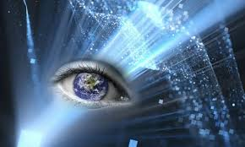
What is Real?
What is True?
What does your Paradigm tell you?
What does empirical evidence tell us?
Notes:
Our paradigm tells us what is what is real - what is true.

Slide 6
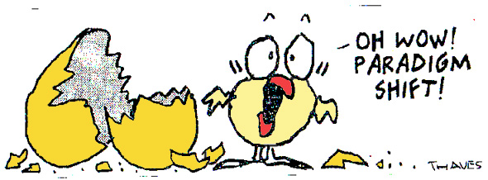
What is Real?
What happens when Science shifts?
Notes:
What happens when it shifts?

Slide 7
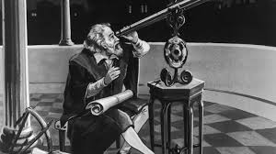
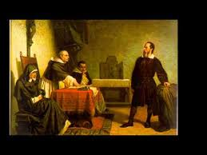
Classic Solar Paradigm: There are Seven Planets
Galileo observing an 8th planet Galileo convicted, under House Arrest

Slide 8
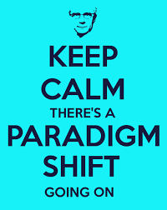
Change can be Challenging
Notes:
Can you imagine the stir this caused? Can you blame Copernicus for not publishing his theory while he was alive?

Slide 9
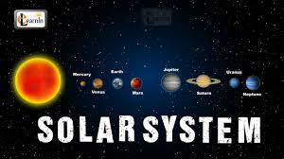
Who do We believe? The Pope or Galileo?
How do we choose?

Slide 10
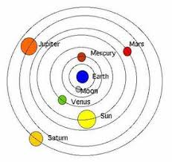
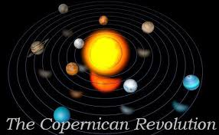
Competing Theories: Ptolemy vs. Copernicus
The Old Theory The New Theory

Slide 11
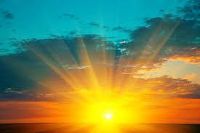

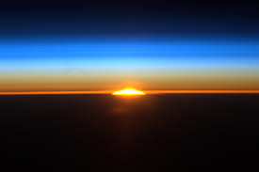
‘Seeing the Sun Move’ around the Earth?
Sunrise Noon Sun Sunset

Slide 12
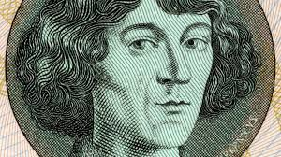
Do we believe our eyes or Copernicus?
Hint: Do we actually see the sun move?
Notes:
We see the sun move around the earth. I’m not moving. The sun is, right?

Slide 13

The Ultimate Mystery
What is Really Real?

Slide 14
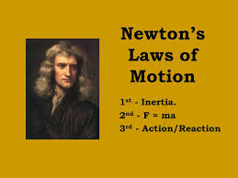
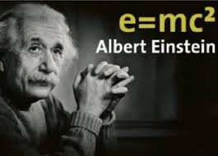
Matter-based Paradigm of Classical Physics versus Unified Field-based Paradigm of Quantum Physics

Slide 15
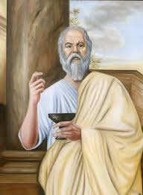
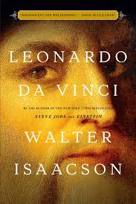
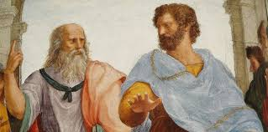
The Renaissance: The Birth of Modern Science
Socrates Plato & Aristotle

Slide 16
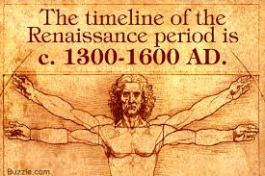
Renaissance: Rediscovering Ancient Science

Slide 17
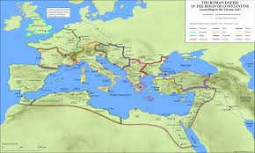
The World’s Wisdom: Modern Science birthed in Ancient Greece

Slide 18
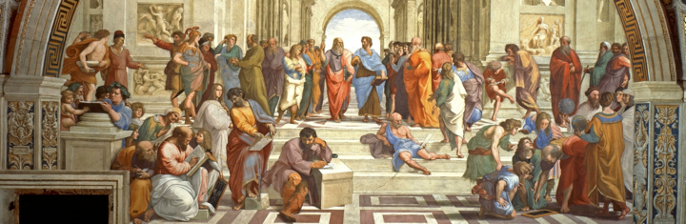
Rediscovering Greek Philosophy
Classical knowledge from ancient Greece and Rome (Socrates, Plato, Aristotle, etc.) and pre-Socratic philosophers (e.g. Democritus, and Leucippus).

Slide 19
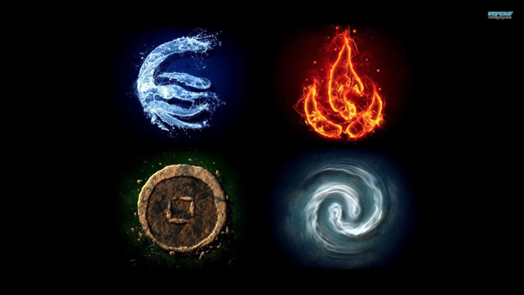
What is the World made of? Earth (solid), Water (liquid), Air (gas) or Fire (heat, light)
Notes:
The natural philosophers were focused on finding out how nature works so they could create predict natural phenomena like the weather and create technologies that used water and air dynamics to improve the lives of their citizens. Thales predicted that there would be a bumper crop of olives and got rich.

Slide 20
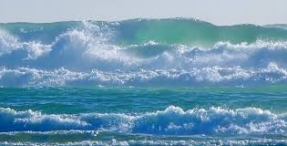
Is Reality ONE or Many?
Notes:
Some said all these appearances (earth, water, air, fire) are all just a manifestation of one underlying substance, just as ice, water and water vapor are different states of water. On the surface we see entropy and random fluctuations but at the depth there is silence and order.

Slide 21

Heraclitus: Ultimate Reality is Non-changing, Unified

Slide 22
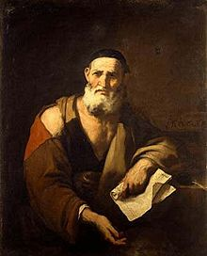
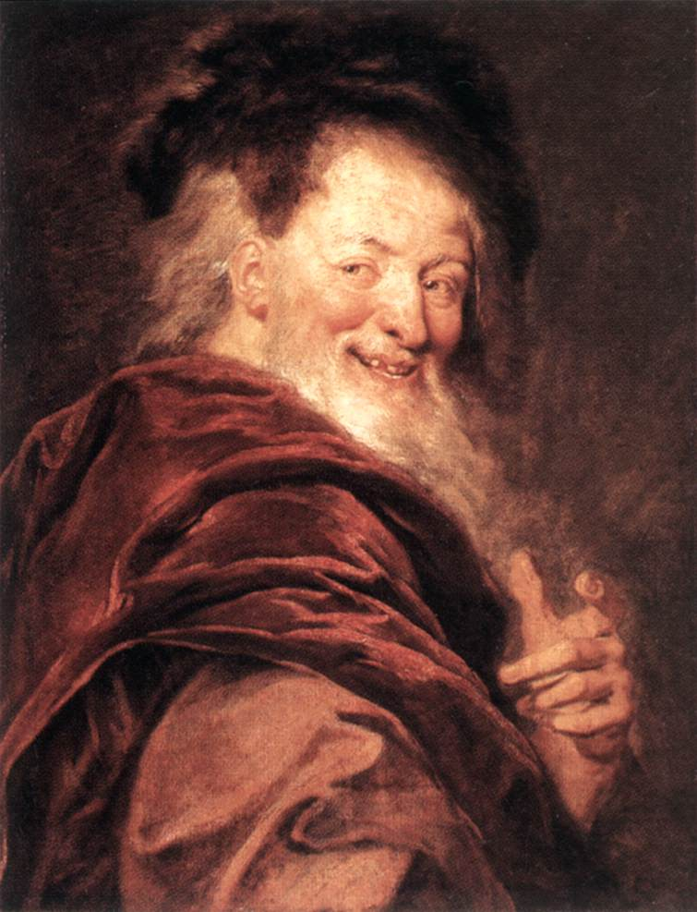
The Atomists: Ancient Greek Natural Philosophers
Leucippus Democritus

Slide 23
Democritus & Leucippus: The Matter-based Paradigm
Many! Everything is Made of Matter
Assumption: Things that are very small and very big are just like things we see everyday
Notes:
Small particles constitute everything. Even air is physical; it must be made up of the same kind of tiny particles as water and earth.

Slide 24
Democritus & Leucippus: The Matter-based Paradigm
Premise #1 Everything is Made of Matter
Premise #2 You can’t divide matter forever

Slide 25
Democritus & Leucippus: The Matter-based Paradigm
Premise #1 Everything is Made of Matter
Premise #2 You can’t divide matter forever
Because that would lead to an Infinite Regress

Slide 26
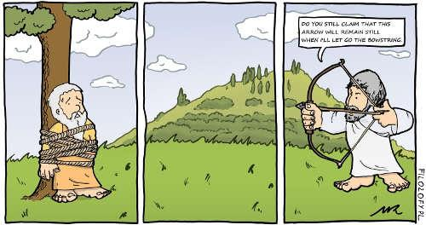
Zeno’s Paradox: Is motion an illusion?
Notes:
Get 3 volunteers: One is the bow, one the arrow and the third is the target.
If we halve the distance forever then the arrow never gets to the target.

Slide 27
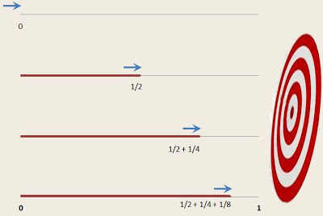
Does the arrow actually reach the target? Logic says No!
Notes:
Because space and time are not infinitely divisible. On the U:F poster point to the Planck Scale and show how there is a limit to how small physics allows space and time to be - 10-34 meters. Also that this mirrors the range of the mind/consciousness. There is a Source of Physical Creation and a Source of thought.

Slide 28
The Matter-based Paradigm
Premise #1 Everything is Made of Matter
Premise #2 You can’t divide matter forever; there is a limit to space & time
Therefore: Everything is made of tiny, indivisible, indestructible pieces of matter
Notes:
Everything is made of atoms, including us. So what are the implications of this?
Inspiration/Insight leading to Premise(s)
Deduce consequences/implications
Test them
How does it hold up?

Slide 29
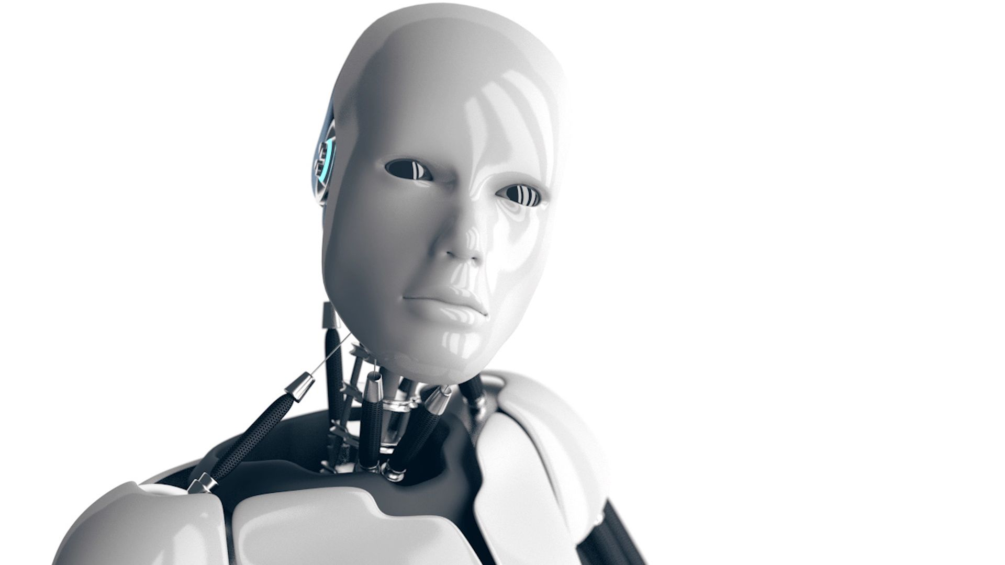
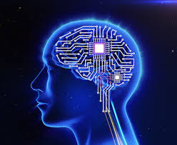
Deduction: Consequences of the Matter-based Paradigm
We are Machines with Computers for Brains

Slide 30
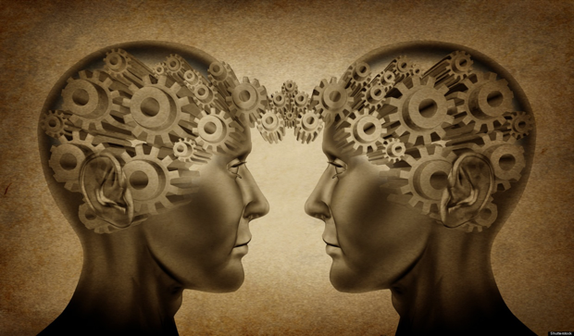
The Mind is an Illusion; Love is Biochemical
Notes:
Do you agree?

Slide 31
Exercise Question:
If Everything is made of indestructible,indivisible particles then what are we?
Am I a machine? Are you?
What is your ultimate paradigm?

Slide 32
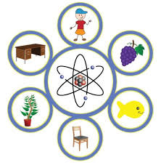
Why did Quantum Physics replace Classical Physics?

Slide 33
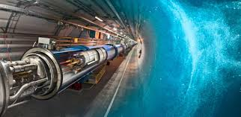
Testing the Paradigm: Is the Universe made up of tiny indivisible pieces of matter (e.g. atoms)?

Slide 34
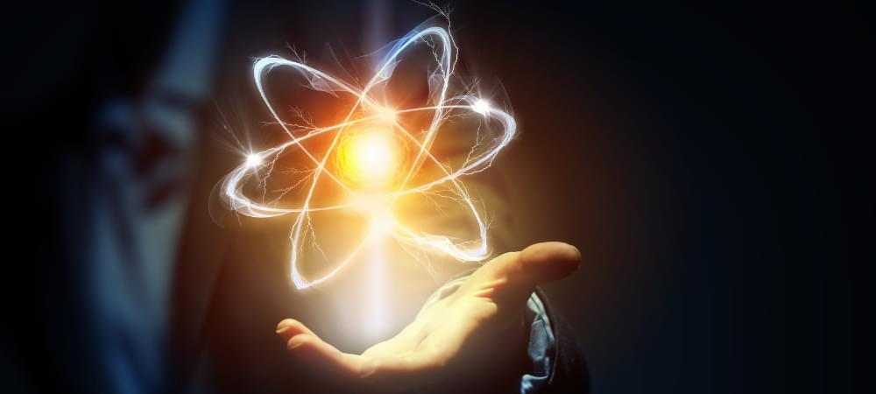
10 ⁰ One meter
10 ⁻² Ant
10 ⁻⁴ Cell Microbe Microbiology
10 ⁻¹ DNA
10 ⁻⁵ Virus
10 ⁻¹⁰ Atom
10 ⁻¹⁵ Proton/Electron Chemistry
10 ⁻¹⁹ Quark Elementary Particles
10 ⁻³⁴ Superstrings
________The Planck Scale:Space & Time exist above
Virtual Reality: The Vacuum State/The Absolute

Slide 35
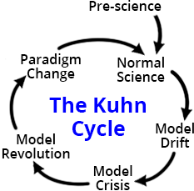
Testing the Matter-based Paradigm:
Does research validate the Paradigm?
Notes:
Does research validate that everything is made of atoms? Are atoms the smallest constituent of the physical universe; are they indestructible, indivisible, localized pieces of matter as the Atomists surmised.

Slide 36
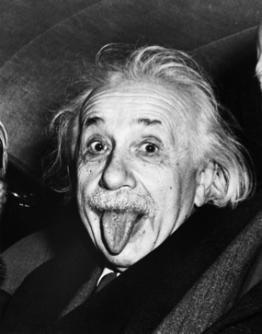
Why was the Classical Matter-based Paradigm replaced by Quantum Physics/Relativity Theory? Is the Matter-based Paradigm consistent
with Quantum Physics?
Einstein expressing his feelings about the old, Matter-based Paradigm.

Slide 37
Is Newtonian Mechanics (Matter-based Science)
Still Useful?
Matter-based Science does not account for the Experience of Reality at very tiny space-time dimensions. It is therefore Incomplete.
Is a limited paradigm still useful in a limited setting? Do we still use Newtonian equations?

Slide 38
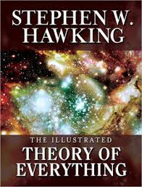
Final Questions
What would the Ultimate Paradigm look like?
Would it be a Theory of Everything?
What would Everything include?

Slide 39
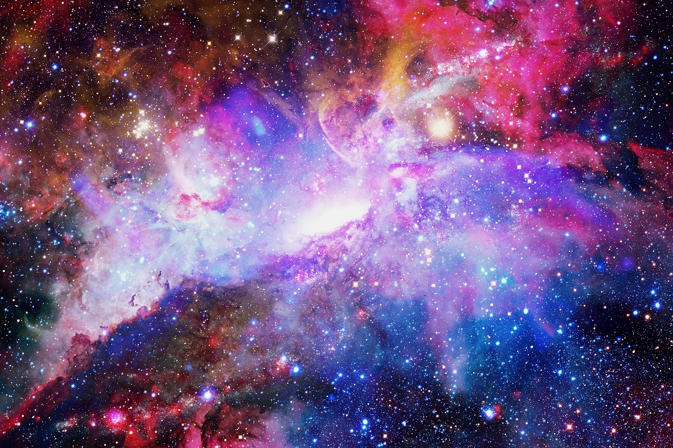
The Physical Universe in Powers of Ten meters: Life is Found in Layers
10 ²⁸ Size of Observable Universe Cosmology
10 ²⁴ SuperCluster of Galaxies
10 ²³ Local Cluster of Galaxies AstroPhysics
10 ²⁰ Our Milky Way Galaxy
10 ¹⁴ Our Solar System
10 ⁷ Earth MacroEconomics
10⁶ Continent Geology
10 ⁶ Ecosystem Ecology
10 ⁶ United States: Sociology, Political Science, Anthropology
10 ⁴ Fairfield Hospital Medicine
10 ² Arts Center
10 ¹ Human Being Biology

Slide 40
10 ⁰ One meter
10 ⁻² Ant
10 ⁻⁴ Cell Microbe Microbiology
10 ⁻¹ DNA
10 ⁻⁵ Virus
10 ⁻¹⁰ Atom
10 ⁻¹⁵ Proton/Electron Chemistry
10 ⁻¹⁹ Quark Elementary Particles
10 ⁻³⁴ Superstrings
________The Planck Scale:Space & Time exist above
Virtual Reality: The Vacuum State/The Absolute

Slide 41
The Four BIG Questions:
Connection of Objective Reality THE KNOWN to Subjective Reality, THE KNOWER
Question #1: Is the Consciousness-based Paradigm consistent with Quantum Physics?

Slide 42
Question #1
Is the Consciousness-based Paradigm consistent with Quantum Physics?
Question #2
One or Many? Do they both describe Ultimate Reality as Unified?

Slide 43
Einstein’s General Theory of Relativity It’s All the Geometry of the Space-Time Continuum

Slide 44
Question #3
What does the Consciousness-based Paradigm include/explain that Objective Physics does not? How does including Subjectivity (i.e. the Observer, the Knower) make the Unified Field Paradigm more complete?
What revolutionary technologies does it provide?

Slide 45
Quantum Physics: The Observer Effect
Central to Quantum Physics is the notion that an event cannot occur, a particle cannot come into existence, until it is observed, which gives a special, critical role to the observer in physics. This is known as the ‘Observer Effect,’ which is central to the Copenhagen Interpretation that was developed by the pioneers of Quantum Physics, such as Niels Bohr, Werner Heisenberg, Wolfgang Pauli and others (1924-1927)

Slide 46
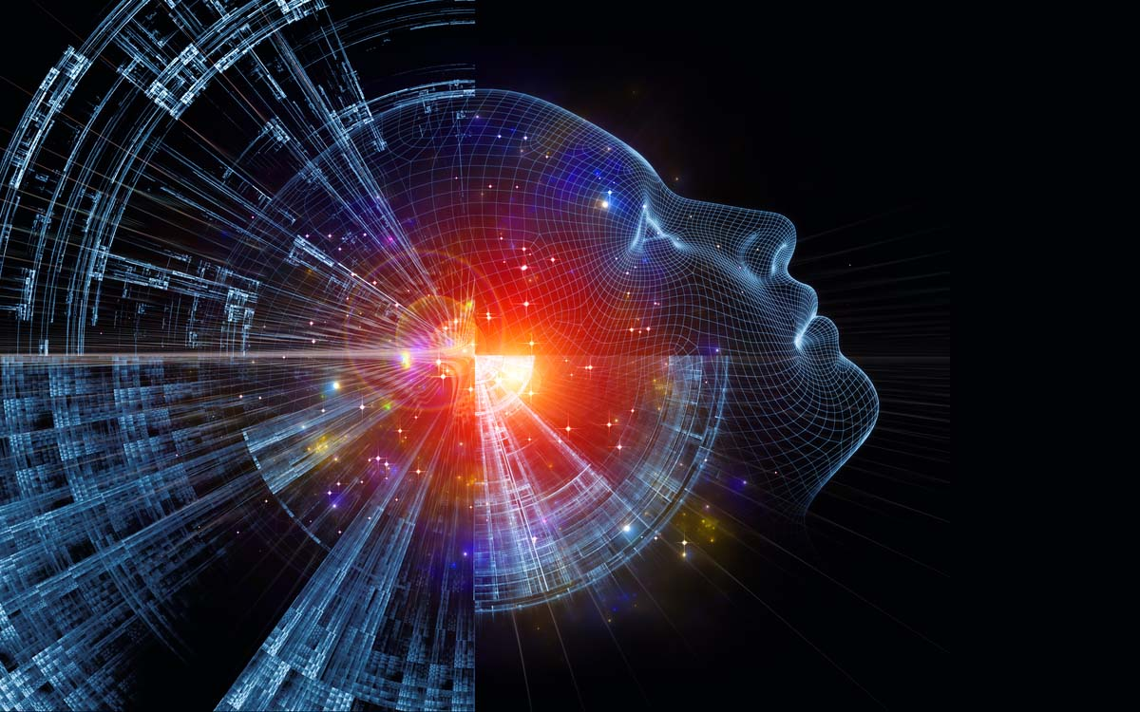
Consciousness-based Paradigm includes the role of the Observer (Subjectivity/Mind/Consciousness)

Slide 47
The Ultimate Paradigm Shift: The Theory of Everything
The Shift from a Matter-Based Paradigm to the Consciousness-Based Paradigm is just rediscovering yourself
Personal Experience: The Observer is You

